Slide 1
PC Control Using Android Mobile Phones Through Bluetooth
Project Guide Project Members
Prof. R. Subhashini, Sivasankar Sabapathy
Assistant Professor (SG) A. Vaneeshkumar
Dept of CSE B. Venkatesh
R. M. Suresh

Slide 2
Outline
Problem Statement
Existing Systems
Proposed System
Module Description
Conclusion
References

Slide 3
Problem Statement
The aim of the project is to easily control a personal computer (PC) using an Android mobile phone via Bluetooth. The PC can also be a home theatre PC or a laptop connected to TV

Slide 4
Existing System
The existing mobile applications are listed:
JM2PC
GMote

Slide 5
JM2PC
Used to remote control the desktop or laptop computer with any JAVA powered phone
Disadvantages
Very complex to port to android mobile phones
Not implemented well for touch screen phones

Slide 6
GMote
Turns Android mobile phone into a remote control for the computer
Disadvantages
Battery is drained quickly due to Wi-Fi
Inane data charges due to 3G

Slide 7
Proposed System
The proposed system will control a PC using Bluetooth. It makes use of an Android phone. It will emulate a keyboard and a mouse. The system will reduce the use of Wi-Fi and 3G thus maximizing battery use and minimizing data charges. It will work in Windows and Linux platforms.

Slide 8
Modules
The modules for the proposed system are:
PC Server App
Mobile Client App
Mouse
PowerPoint and Media Player Remote
Keyboard
Joystick

Slide 9
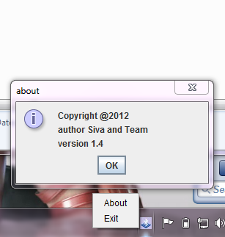
PC Server App
This will allow incoming Bluetooth signals from the mobile
It converts the signals into suitable actions

Slide 10
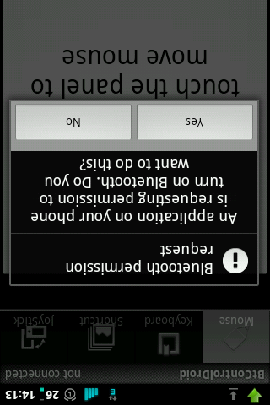
Mobile Client App
This will turn on Bluetooth and emulate mouse and keyboard
It will send the signals from the phone to computer

Slide 11
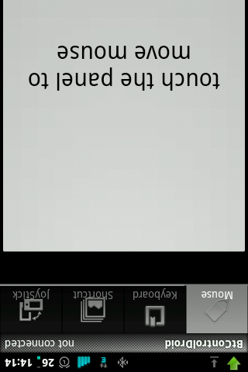
Mouse
This will get Mouse signals and send it to PC
It performs mouse movement, left click, left double click and right click

Slide 12
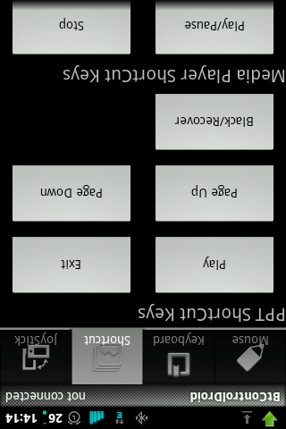
PowerPoint and Media Player
This will control the PowerPoint and Media Player
PowerPoint controls are play, next, previous, quit and black
Media player controls are the general controls

Slide 13
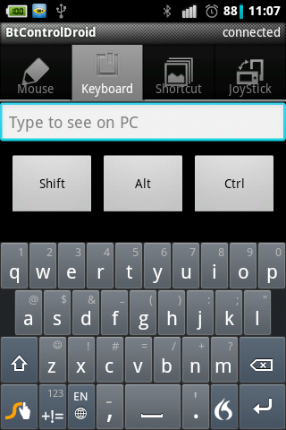
Keyboard
It will use the soft keyboard in the phone to emulate in the PC
The Shift, Ctrl and Alt keys are also emulated

Slide 14
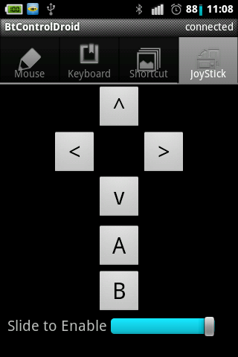
Joystick
Use slider bar to enable or disable joystick
Has 4 directional and 3 playable buttons
The buttons can be set to other keys in the settings menu

Slide 15
Conclusion And Future Works
Advantages of the project
Battery usage is minimized
No use of 3G or Wi-Fi
Runs in Windows and Linux
Simple Connection established using Bluetooth
Future Works include
Run the particular application when a shortcut is pressed
Provide a call filter for the app
A better user interface for the joystick module

Slide 16
References
Barrera, David, and P.C. Van Oorschot (2010) "Secure Software Installation on Smartphones." Security & Privacy, IEEE 9.3 pp.42-48.
Chen, Eric Y., and Mistutaka Itoh (2010) "Virtual Smartphone over IP." World of Wireless Mobile and Multimedia Networks (WoWMoM), 2010 IEEE International Symposium on a” , pp.1-6.
Lee, Wei-Meng (2011) Beginning Android Application Development. Indianapolis, IN: Wiley Pub., 2011.
Meier, Reto (2009) Professional Android Application Development. Indianapolis, IN: Wiley, 2009.
"Android (operating System)." Wikipedia, the Free Encyclopedia. 25 Dec. 2011. Web. 26 Dec. 2011.
<http://en.wikipedia.org/wiki/Android_(operating_system)>.

Slide 17
Thank You

